Slide 1
HEART RATE PULSE COUNTER USING 8051 MICROCONTROLLER AND IR SENSOR
MICRO CONTROLLER PROJECT REVIEW 2
LAVANYA GUNE – 19BEC0367

Slide 2
This project underlines the design of heart rate monitor system using 8051 microcontroller and Photosensor. The circuit is designed in order to calculate the heart rate at the fingertip based on the change in blood volume. The finger is places between Photo diode and transistor and the intensity of reflected light is measured to calculate the heart rate.
OBJECTIVE

Slide 3
The methodology adapted for this project is referred to as photoplethysmography in medical terms. It is the process of optically evaluating the volumetric measurement of an organ. When the heart expands (diastole) the volume of blood inside the fingertip increases and when the heart contracts (systole) the volume of blood inside the fingertip decreases. The resultant pulsing of blood volume inside the fingertip is directly proportional to the heart rate. Aim is to count the number of pulses in one minute, that’s the heart rate in beats per minute (bpm).
METHODOLOGY ADAPTED-

Slide 4
As we are using 8051 microcontroller it is very cost effective. It is portable and provides real time analysis. During covid post treatment most patients suffer from heart trouble and this can help them to track their heart rate. . It is difficult to identify patterns using traditional examinations for those cardiac problems that occur customarily during normal daily activities but disappear the moment the patient is hospitalized. This results in diagnostic difficulties and consequently possible therapeutic errors. Real time monitoring is a boon to such patients.
NOVELTY-

Slide 5
LITERATURE SURVEY
S.NO | Title , journal name, author name, year of publication | Methodology | Pros | Cons
1 | Wireless Heart Rate Monitoring System using MQTT 2016 International Electrical Engineering Congress, iEECON2016, 2-4 March 2016, Chiang Mai, Komkrit Chooruanga, Pongpat Mangkalakeereea, Thailand | Photoplethysmography | Faster | More Costly
2 | Fully Printed Wearable Vital Sensor for Human Pulse Rate Monitoring using Ferroelectric Polymer Sekine, T., Sugano, R., Tashiro, T. et al. Fully Printed Wearable Vital Sensor for Human Pulse Rate Monitoring using Ferroelectric Polymer. Sci Rep 8, 4442 (2018) | Using an oscilloscope (MDO3000, Tektronix) and a waveform generator | Flexible and wearable | More Costly
3 | H. K. Azman, A. H. Q. A. Talib and K. Kadir, "Development of a Low-Power Heart Rate Monitor Device for Observation of Heart Rate Variability," 2019 IEEE International Conference on Smart Instrumentation, Measurement and Application (ICSIMA), Kuala Lumpur, Malaysia, 2019 | Electrocardiogram with post-processing | More accuracy | Time consuming

Slide 6
COMPONENTS REQUIRED
CNY70 OPTOCOUPLER
8051 MICRO CONTROLLER
SEVEN SEGMENT 1 DIGIT LCD DISPLAY-3
RESISTORS
CAPACITORS
CRYSTAL OSCILLATOR (11.0593MHz )
LM324 QUAD OPERATIONAL AMPLIFIER(3)
BJT-2N2222-4
SOWFWARE REQUIRED- 1. KEIL 2. PROTEUS

Slide 7
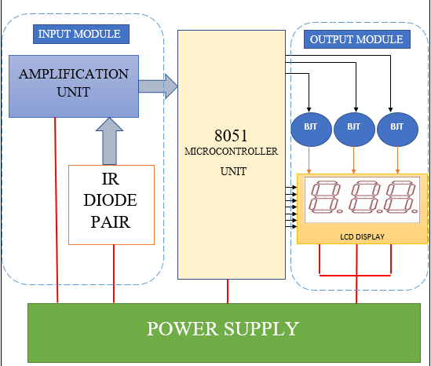
BASIC BLOCK DIAGRAM-

Slide 8
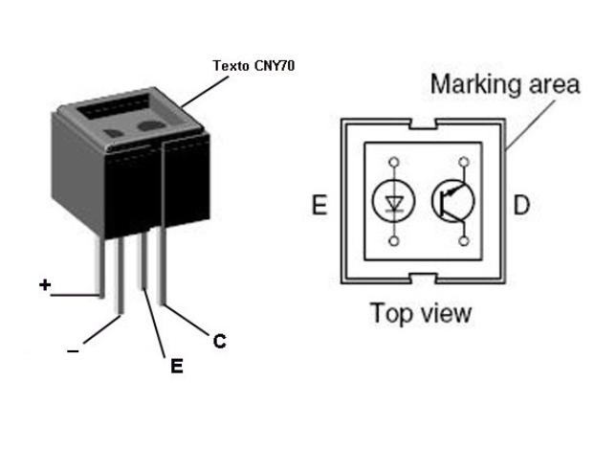
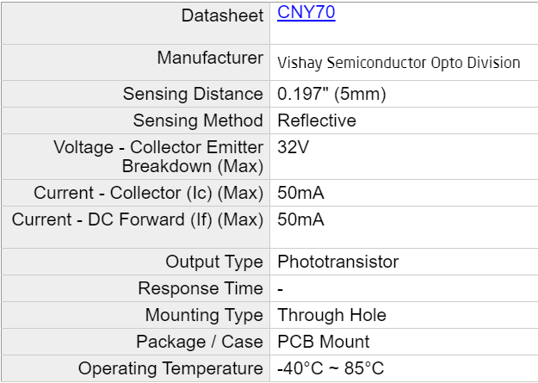
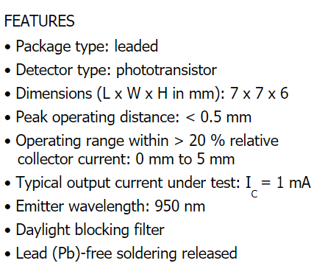
CNY70 OPTICAL SENSOR-

Slide 9

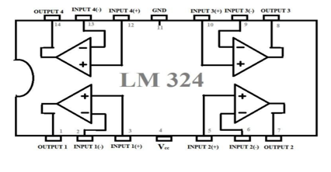
LM324 OP AMP-
https://www.ti.com/lit/ds/snosc16d/snosc16d.pdf

Slide 10
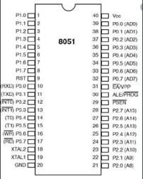
MICROCONTROLLER UNIT-
CODE IS WRITTEN IN ASSEMBLY LANGUAGE, THE INTERNAL TIMERS ARE USED TO COUNT AND PROVIDE DELAY. PORT P2 IS USED FOR DISPLAY ON LCD.PORT P3.5 USED AS INPUT PIN. PORT P1 IS USED TO SWITCH BETWEEN THE LCD.

Slide 11
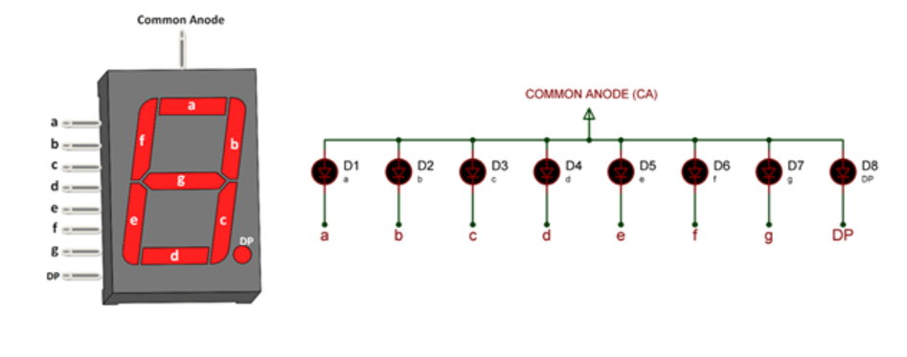
OUTPUT UNIT-
THREE LCD ARE USED TO PROVIDE A 3 DIGIT OUTPUT , THE LCD SCREEN IS WITCHED USING A BJT OPERATING IN CUTOFF AND SATURATION MODE.
The Red colour one is universally used since it consumes less current than other colours.
14.20mm with Red colour display

Slide 12
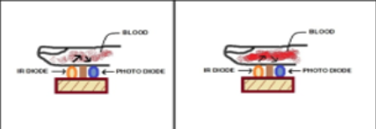
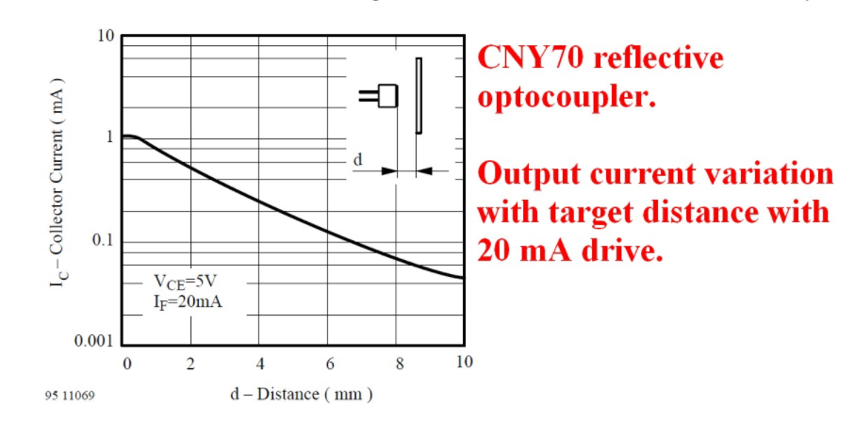
WORKING OF THE CIRCUIT-(ALGORITHM)
STEP 1-
A CNY70 optical sensor is used to sense the reflected light. Finger is placed between the transmitter and receiver probe of sensor. When more light falls on the photo transistor it conducts more, its collector current increases and so its collector voltage decreases. When less light falls on the photo transistor it conducts less, its collector current decreases and so its collector voltage decreases. This variation in the collector voltage is proportional to the heart rate.

Slide 13
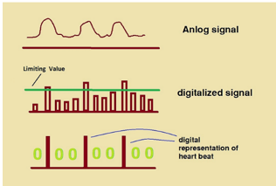


Signal received by the photo transistor is very weak and perturbed by high frequency noise. For this signal to be processed in Microcontroller, undesired noise needs to be eliminated. In addition, the signal level has to be raised to an acceptable level so that the spikes coming from the photo transistor every time the heart beats can be distinguished clearly in the Microcontroller. For noise reduction and amplification purpose, three QUAD OP-AMP are used. Reflection method is used as it serves better performance. The received signal is passed through two consecutive filters to block dc components. Signal components below a defined cut-off frequency are amplified. For this amplification purpose OP-AMP LM324 with class A output stage is used that amplifies the original signal almost ten thousand times. Thus, high frequency components (ripple or noise) automatically get attenuated throughout this amplification process.
STEP 2-

Slide 14

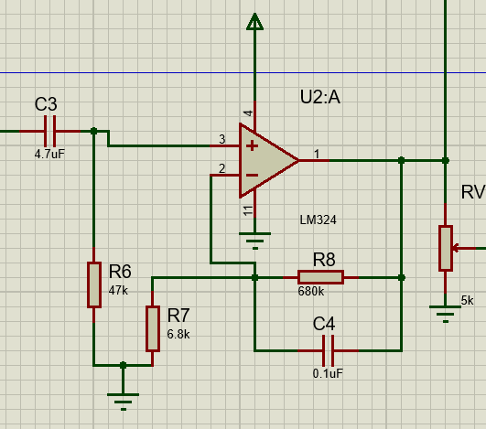
PASSIVE HIGH PASS FILTER
ACTIVE LOW PASS FILTER
f cut-off = 0.7Hz
f cut-off = 2.34 Hz
Any frequency lower than 60 Hz is filtered out as it is noise from the surrounding
If the frequency was < 30 Hz , then it belongs to the category of the abnormal heart sound, as third and fourth heart sounds and the diastolic murmur of mitral stenosis .
BAND PASS FILTER

Slide 15
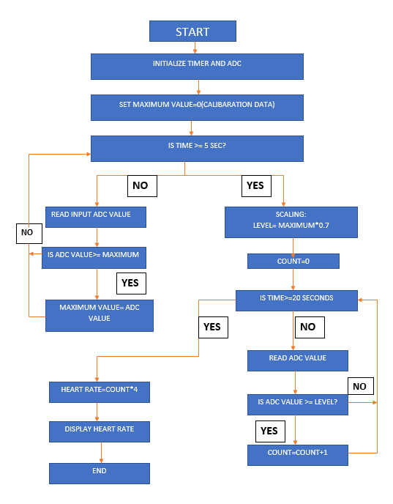
ALGORITHM
Output has to be displayed as BPM (beats per minute) however it is a tough task to measure for one minute. Hence we scale down the time to 15 secs and the final count will be multiplied by 4 to get BPM.

Slide 16
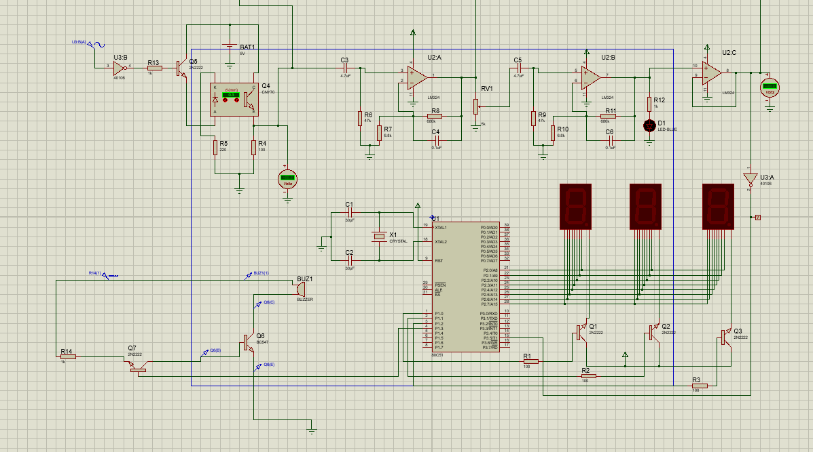
CIRCUITRY-

Slide 17
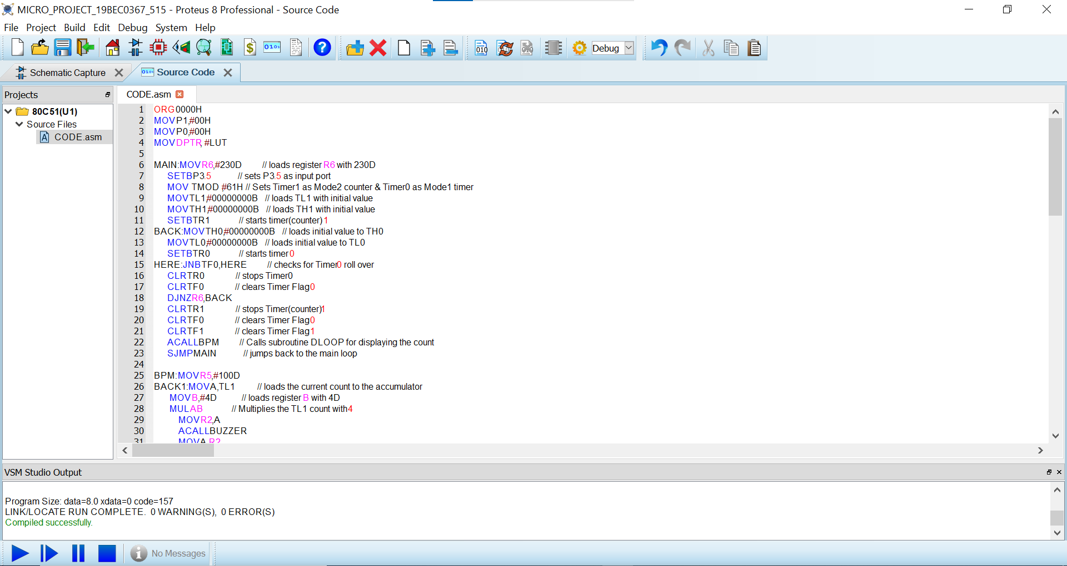

Slide 18
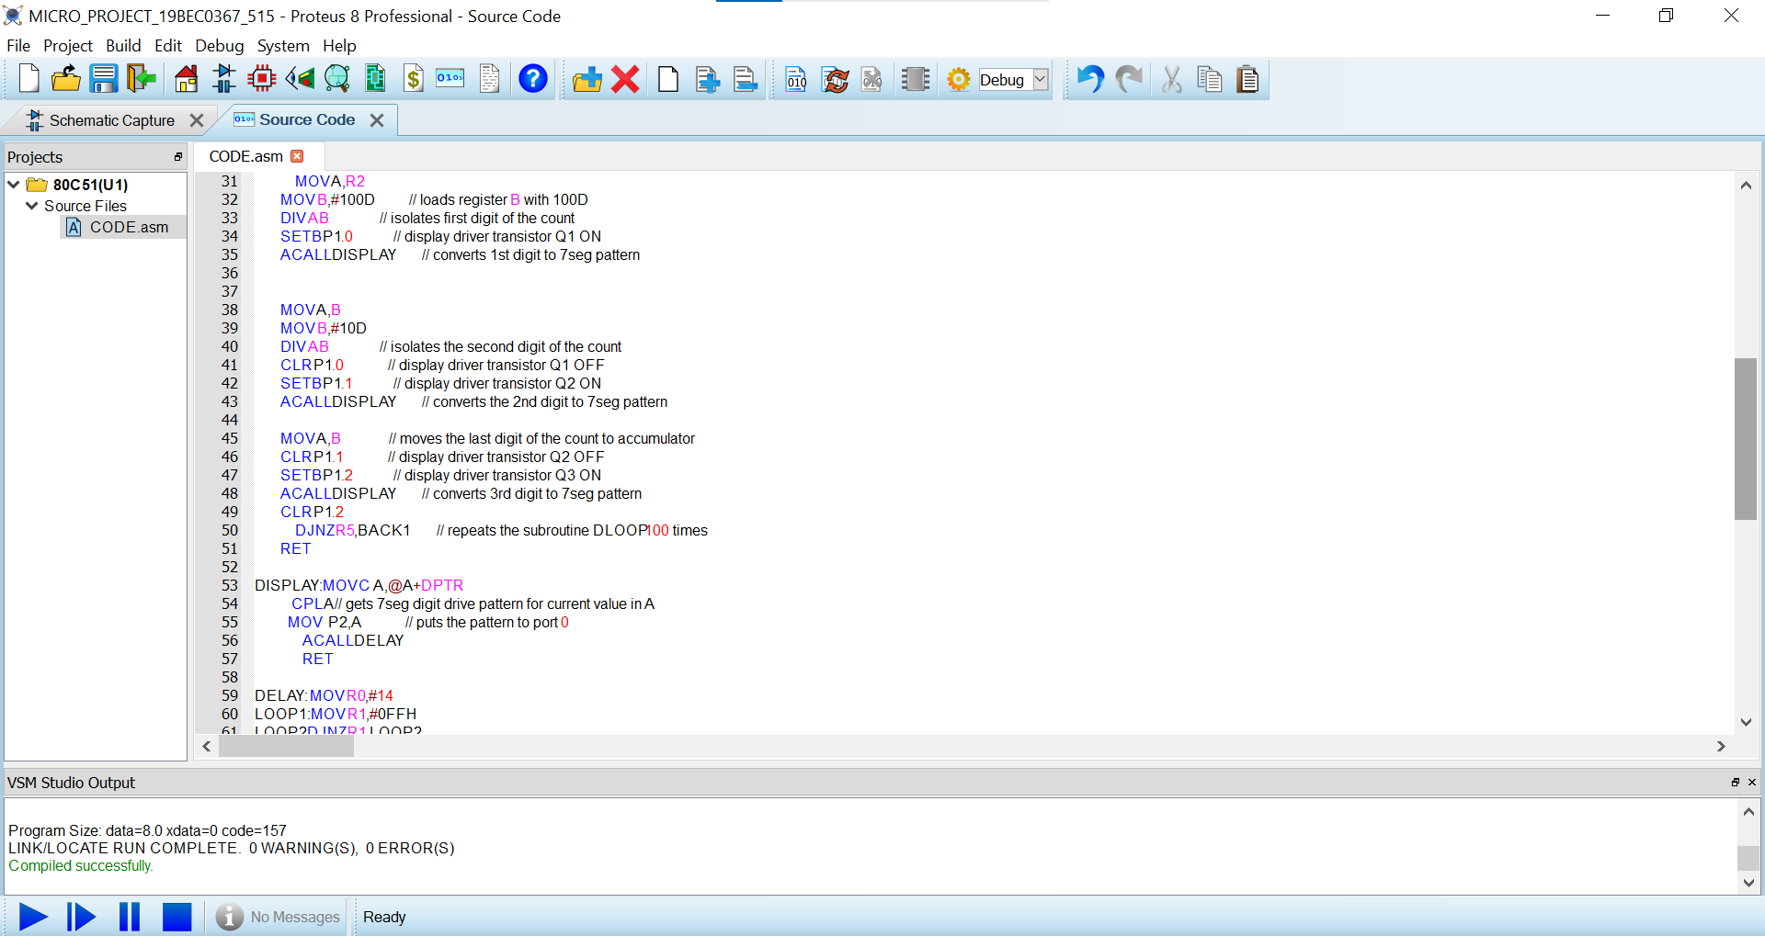

Slide 19
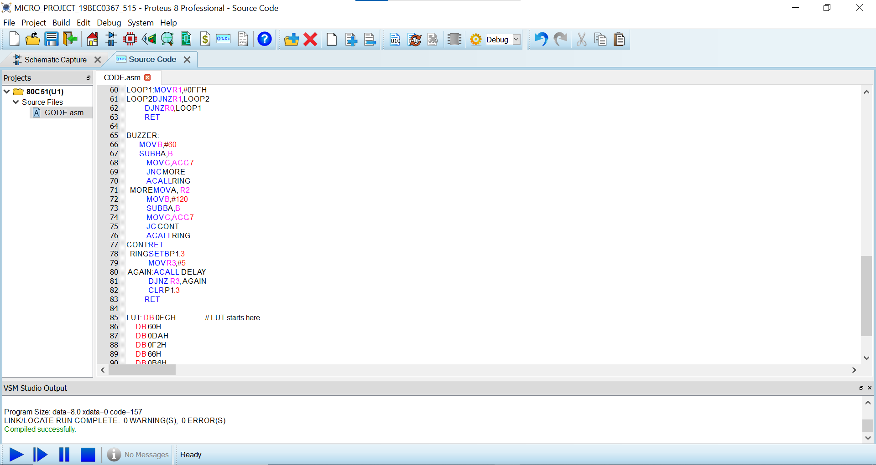

Slide 20
